Slide 1
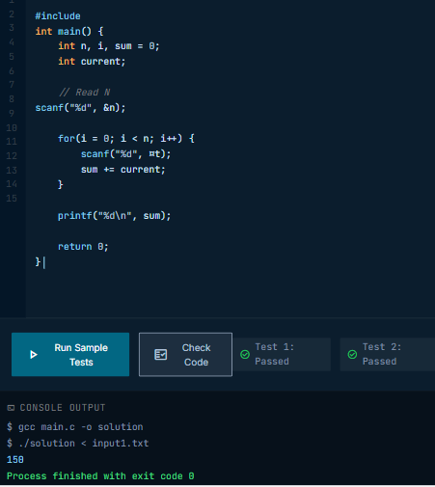

Cont/x
A Low-Level Keyboard-Hook Lockdown and On-Device Compiler-Based Assessment Engine for Secure Programming Exams
Aratia, Brian Joseph B. • Avelino, Robert Emmanuel C. • Perez, Mel Stephen A.

Slide 2




The Problem
No Desktop Lockdown
Server-Side Bottlenecks
Cloud tools only restrict browsers — Alt+Tab, Task Manager, and OS-level shortcuts remain open.
Simultaneous submissions to remote grading servers cause delays during time-limited exams.
Unreliable Connectivity
No Unified Platform
Many Philippine schools face unstable internet, making cloud-only platforms risky for live exams.
No single tool combines system-level security AND automated code assessment together.

Slide 3






Proposed Solution
Cont/x
A Desktop and Web Application for Enforcing Academic Integrity through System-Wide Lockdown and On-Device Automated Assessment
System-Wide Lockdown
Local Code Compiler
Teacher Dashboard
Intercepts Alt+Tab, Windows key, Task Manager, copy-paste, screenshots at OS level
Compiles and executes C programs locally via GCC/MinGW — no server needed
Live monitoring, violation alerts, and session control from any browser
Multi-Type Exam Builder
Cloud Sync & Storage
Export Reports
Multiple Choice, Fill-in-the-Blank, and Coding questions in one exam
Centralized records, submissions, and violation logs stored securely
CSV result sheets and incident reports generated instantly after the exam

Slide 4
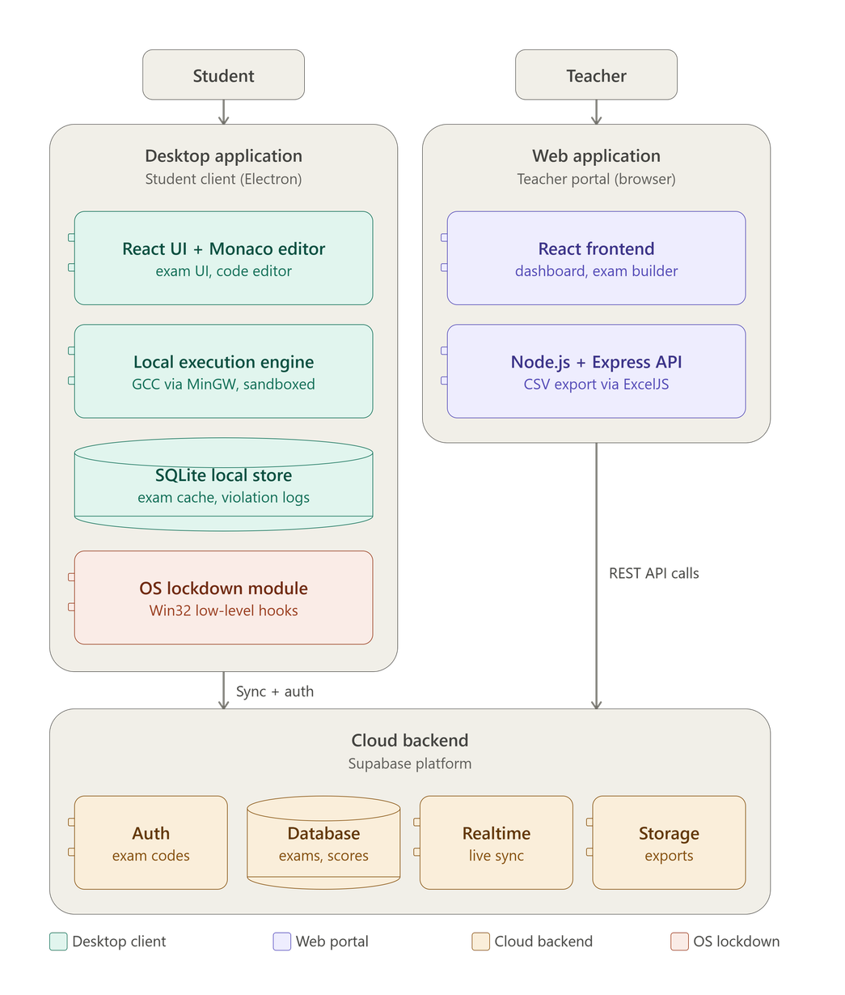
System Architecture
Two Entry Points
Student Side - Desktop App
Teacher Side - Web App
  Monaco editor + local GCC/MinGW compiler (grades on-device)
  SQLite caches exam data locally
  OS Lockdown Module disables Alt+Tab, Start menu, copy-paste, Task Manager via Win32 hooks
  React dashboard + exam builder
  Node.js/Express handles exam creation, local server compiler and CSV export
Cloud Backend
Key Design Principle
  Auth → single-use exam codes
  Database → exams, scores, violations
  Realtime → live teacher dashboard updates
  Storage → exported files
  Grading and lockdown happen locally, bandwidth doesn't affect exam performance
  The cloud's only job is keeping records accurate and the teacher's dashboard live

Slide 5
Lockdown & Security
What's Intercepted & Blocked
How It Works
  Alt+Tab and all app-switching shortcuts
1
When student starts their exam session → lockdown activates simultaneously on their machines
  Windows key and Start menu
2
SetWindowsHookEx (WH_KEYBOARD_LL) intercepts OS-level keyboard input in Ring 3 userspace
  Task Manager (Ctrl+Shift+Esc, Ctrl+Alt+Del)
3
Fullscreen always-on-top kiosk window captures focus
  Copy-paste (Ctrl+C / Ctrl+V / Ctrl+X)
4
Active process monitoring flags disallowed apps instantly
  Screenshot tools (PrintScreen, Win+Shift+S)
  Disallowed applications (process monitoring)
5
Bypass attempts silently logged with timestamps on teacher dashboard
  System audio (muted on launch)
6
Lockdown released only when teacher explicitly ends the session or when student enters exit code

Slide 6
Assessment Engine
1
2
3
Student Writes Code
Local GCC Compiles
Checks Against Samples
Monaco Editor (VS Code engine)
Process isolation, time limits
Visible test cases before submit
6
5
4
Score Returned
Final Submission
Hidden Test Cases Run
Partial credit + attempt deductions
Point deduction per check attempt
Teacher-defined, never visible

